Slide 1


Group-1
Abhishek Anand
Esa Hassan
A K Nynesh
Harshith GS
ANJANEYA
BHARGAVI V
PES UNIVERSITY
Bangalore
MTech DSAI
PYTHON PROJECT PRESENTATION ON
FOOD DELIVERY TIME

Slide 2
Contents
Objectives
Dataset Overview
Missing Values
Histogram Insights
Boxplots by Categories
Scatter Plot
Correlation Heatmap
Summary and Conclusion

Slide 3
Objectives
To analyze food delivery time data in order to identify the key factors that influence delivery efficiency.
uncover patterns that contribute to faster or delayed deliveries.
This exploratory analysis will help understand operational bottlenecks, assess rider performance, evaluate the effect of environmental and contextual variables.
Provide actionable insights to improve overall delivery speed and reliability.

Slide 4
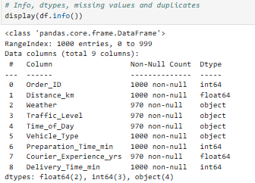
Dataset Overview
Dataset Loading & Summary
The dataset was imported using:
df = pd.read_csv("Food_Delivery_Times.csv")
A structural summary of the dataset was generated using df.info(),
  Total number of rows (records)
  Total number of columns (features)
  Data types of each column
  Count of non-null values (useful for identifying missing data)
The dataset includes key variables related to delivery operations, such as:
  distance – numerical (float/int), measuring kilometres or miles
  preparation_time – numerical, time taken by restaurant to prepare the order
  traffic_level – categorical (e.g., Low, Medium, High)
  weather – categorical (e.g., Clear, Rainy, Cloudy, Stormy)
  rider_profile – categorical or mixed (e.g., experience, rating)
  delivery_time – numerical, total time taken to complete delivery
The dataset contains a mix of numerical (int/float) and categorical (object) columns, which helps in performing diverse EDA tasks such as correlation analysis, grouping, and pattern identification.

Slide 5
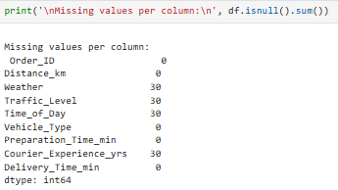
Missing Values
Checked missing values using df.isnull().sum()
• Identified which columns (numerical & categorical) contained missing entries
• Helped estimate the extent of data cleaning required.
Missing values detected across multiple features
• Numerical attributes like distance, Time of day, etc.
• Categorical attributes like weather, traffic level, rider profile
Missing Value Strategy Applied
• Numerical Columns → Filled using median
→ More robust than mean when outliers are present
→ Preserves central tendency without skewing data
• Categorical Columns → Filled using mode
→ Ensures logical replacements with the most frequent category
→ Avoids introducing artificial categories

Slide 6
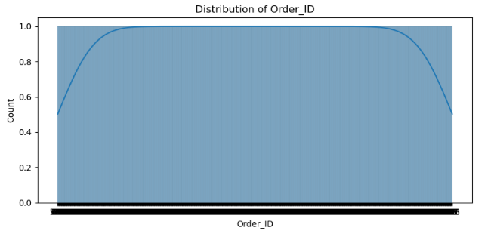
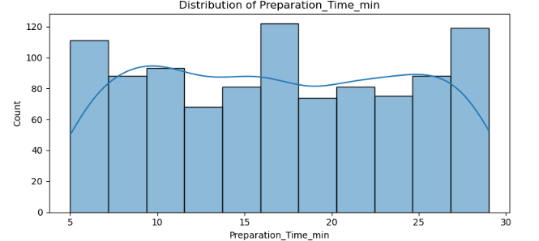
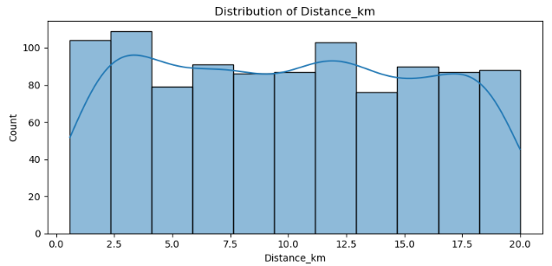
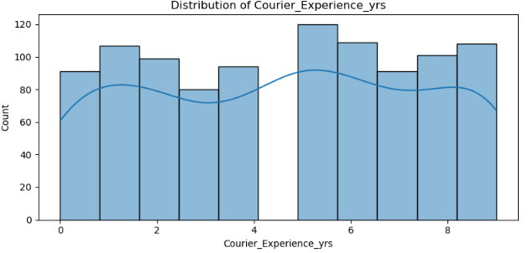
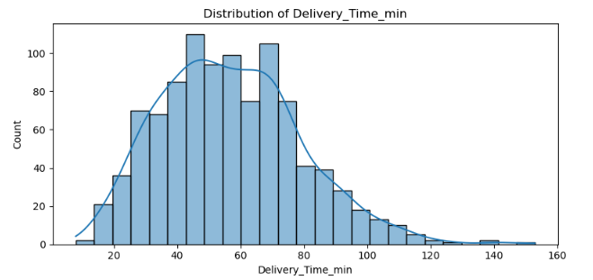
Histogram Insights – Numerical Features
Delivery Time shows a moderate skew, indicating some variation toward higher values.
Distance distribution is right-skewed, suggesting a few longer-distance deliveries that extend the tail.
Preparation Time is tightly clustered, reflecting consistent restaurant prep durations.
Histograms help in early detection of outliers across numerical variables.
KDE curves reveal underlying density patterns, highlighting how data is concentrated.
These visual patterns identify influential variables and guide deeper EDA decisions

Slide 7
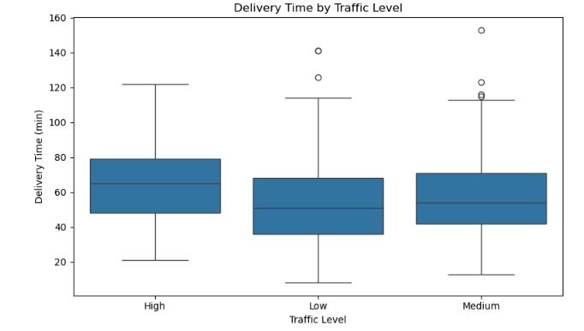
Boxplots – Traffic Level vs Delivery Time
Delivery time increases consistently from Low → Medium → High traffic levels, indicating a clear upward trend.
High traffic conditions show the widest spread, reflecting greater variability in delivery durations.
Outliers are more prominent under high traffic, suggesting unpredictable delays.
Boxplots reveal how categorical factors (like traffic level) affect numerical targets (delivery time).
This analysis confirms traffic as a strong influencing variable in predicting delivery performance.

Slide 8
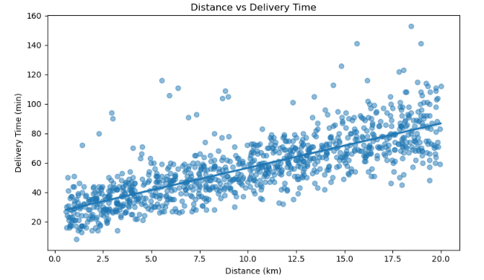
Scatter Plot – Distance vs Delivery Time
A positive correlation is observed, indicating that as one variable increases, the other tends to rise as well.
The scatter plot shows a generally linear trend, though with some natural variability.
The regression line clearly highlights the direction and strength of the relationship.
Outliers reveal unusual delivery scenarios, such as extreme delays or atypical distances.
This analysis helps identify potential logistical bottlenecks and areas for operational improvement.

Slide 9
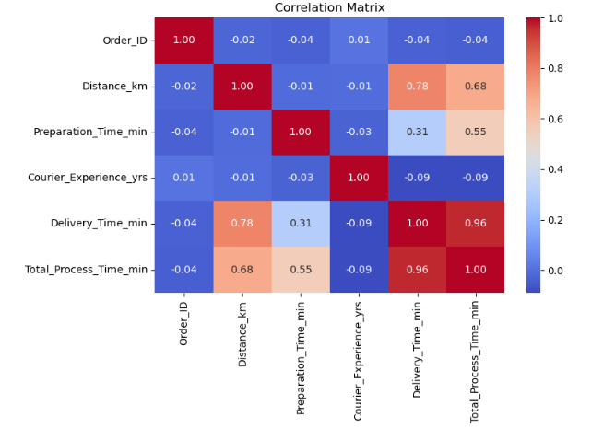
Correlation Heatmap
Visualizes relationships among all numerical features, helping reveal underlying patterns.
Delivery time shows strong correlations with both distance and preparation time, indicating they are key drivers of overall delivery duration.
Other numerical features exhibit weak or minimal correlation, suggesting limited direct influence.
This analysis highlights the most important variables and supports targeted feature engineering for improved modeling and insights.

Slide 10
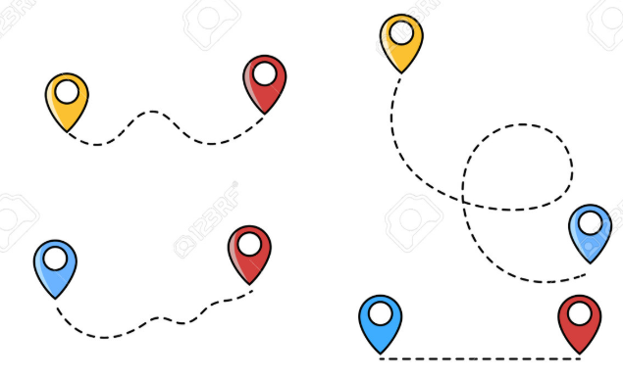





Summary & Conclusion
Delivery time is primarily influenced by three key factors:
Distance – longer routes consistently increase delivery duration
Preparation Time – delays at the restaurant directly extend total time
Traffic Level – congestion significantly slows down rider movement
Weather and rider profile show only minor impact, indicating they play a secondary role in determining delivery efficiency.
Overall, the analysis highlights the most influential operational factors and provides a clear foundation for optimizing delivery performance.

Slide 11
THANK YOU

